Slide 1
PySpark Integration
RedShift And Kafka

Slide 2
Agenda
Apache Spark Integration
Why we need Integration?
What is ETL?
PySpark Integration with RedShift
PySpark Integration with Kafka
Lab: Implementation

Slide 3
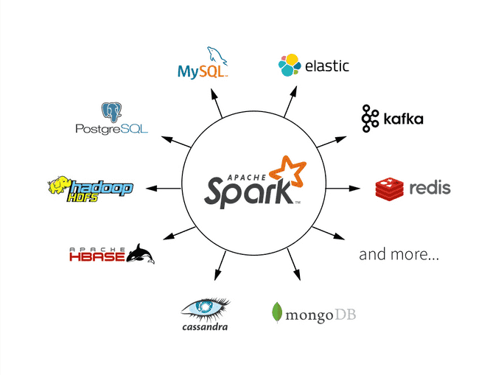
Apache Spark Integration
What is Integration.
Read write data from Anywhere.
Easy to integrate with Hadoop tools.
Like Hive, Hbase etc
Easy to integrate with Cloud Platform.
Like AWS, GCP and Azure

Slide 4
Why we need Integration with Spark
To make faster data Processing
Sometimes we need to process petabytes of data but data is stored in a particular server. When we process data on that server here it will take lot of time. In that case we need to integration with spark to fast data processing.
Eg. Hadoop process data in 100 min but when we integrate spark with Hadoop then it will take 10 mins to process data.

Slide 5
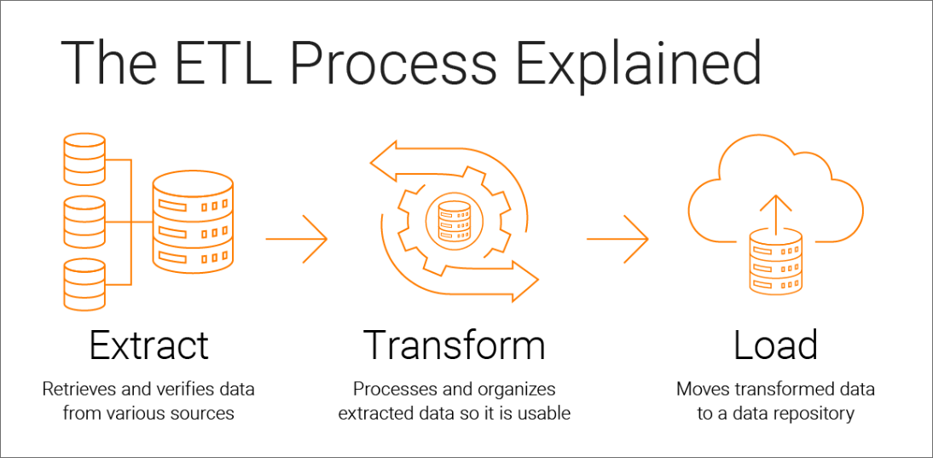
Extract, Transform and Load (ETL)
ETL is used for data Pipeline.
Extract:-
Extract data from servers, database, etc.
Transformation:
Transform extracted data from the source.
Load:
Ingest transformed data to the destination.

Slide 6

Redshift - Introduction
Amazon Redshift is a fully managed data warehouse service in the cloud
It is used for large-scale data set storage and analysis
It is a SQL database and Uses SQL-like query
Amazon Redshift uses SQL to analyze structured and semi-structured data across data warehouses, operational databases, and data lake.
Easy to code

Slide 7
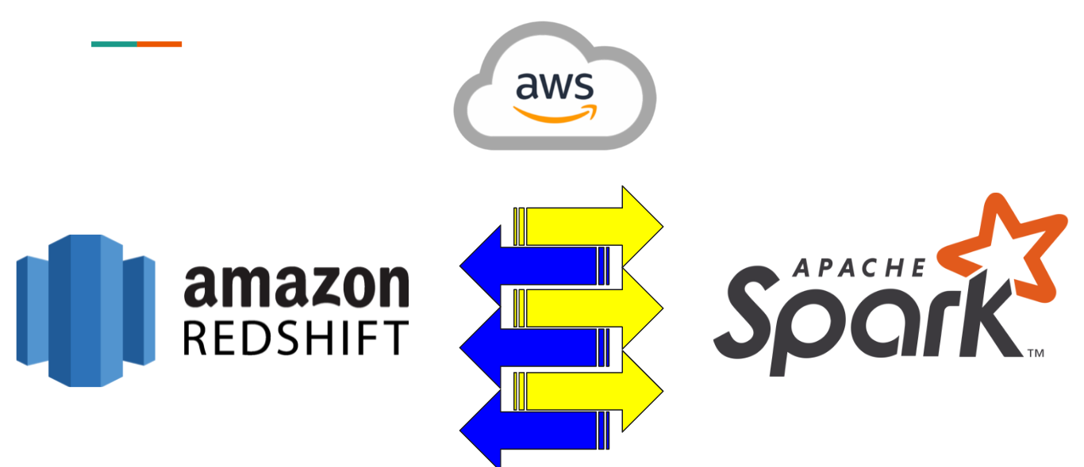
Why PySpark Integration with RedShift?
To utilize Sparks lightning speeds and its components for various functions on your data and use Redahifts querying capabilities simultaneously

Slide 8

Kafka - Introduction
Kafka is a distributed data store optimized for ingesting and processing streaming data in real-time. Streaming data is data that is continuously generated by thousands of data sources, which typically send the data records in simultaneously. A streaming platform needs to handle this constant influx of data, and process the data sequentially and incrementally
Kafka provides three main functions to its users:
Publish and subscribe to streams of records
Effectively store streams of records in the order in which records were generated
Process streams of records in real time
Kafka is primarily used to build real-time streaming data pipelines and applications that adapt to the data streams. It combines messaging, storage, and stream processing to allow storage and analysis of both historical and real-time data

Slide 9
Why PySpark Integration with Kafka?
Kafka is a potential messaging and integration platform for Spark streaming.
Kafka act as the central hub for real-time streams of data and are processed using complex algorithms in Spark Streaming.
Once the data is processed, Spark could be publishing results into yet another Kafka topic or store in HDFS, databases or dashboards.

Slide 10
Lab - Implementation
Start Integration with Redshift.
Start Integration with Kafka.

